Slide 1
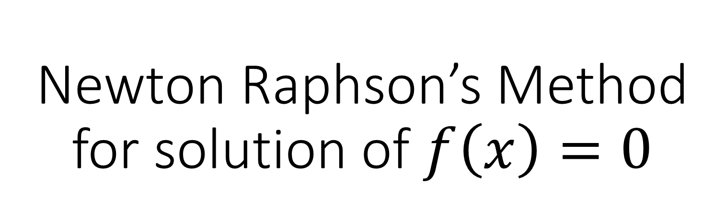
Newton Raphson’s Method for solution of $f\left(x\right)=0$

Slide 2
Introduction
The Newton Raphson Method is referred to as one of the most commonly used techniques for finding the roots of given equations.
It can be efficiently generalised to find solutions to a system of equations.
Moreover, we can show that when we approach the root, the method is quadratically convergent.
Here, you will learn how to use the Newton Raphson method to find the roots or solutions of a given equation, and the geometric interpretation of this method.

Slide 3
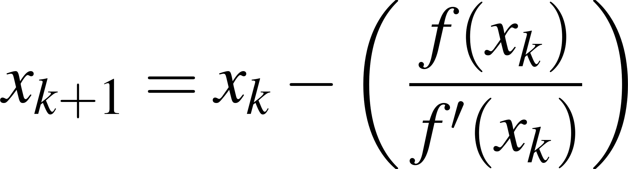
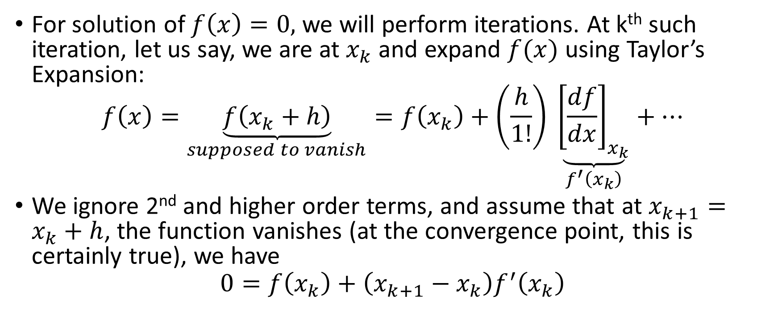
Newton’s method formula
For solution of $f\left(x\right)=0,$ we will perform iterations. At k^{th} such iteration, let us say, we are at $x_{k}$and expand $f(x)$ using Taylor’s Expansion:
$$f\left(x\right)=\underset{supposed to vanish}{\underbrace{f\left(x_{k}+h\right)}}=f\left(x_{k}\right)+\left(\frac{h}{1!}\right) \underset{f^{′}\left(x_{k}\right)}{\underbrace{{\left[\frac{df}{dx}\right]}_{x_{k}}}}+…$$
We ignore 2nd and higher order terms, and assume that at $x_{k+1}=x_{k}+h$, the function vanishes (at the convergence point, this is certainly true), we have
$$0=f\left(x_{k}\right)+\left(x_{k+1}−x_{k}\right)f^{′}\left(x_{k}\right)$$
Newton’s Formula

Slide 4








Geometrical Interpretation
$$Slope:$$
$$f^{′}\left(x_{k}\right)= \frac{f(x_{k})}{x_{k+1}−x_{k}}$$
$${f(x}_{k})$$
tangent
$${y=f(x)}_{}$$
$${f(x}_{k})$$
Root
$$x_{}$$
$$x_{k+1}$$
$$x_{k}$$
$${x_{k+1}−x}_{k}$$

Slide 5


Geometrical Interpretation
$$Slope:$$
$$f^{′}\left(x_{k}\right)= \frac{f(x_{k})}{x_{k}−x_{k+1}}$$
$${f(x}_{k})$$
tangent
$${y=f(x)}_{}$$
$${f(x}_{k})$$
Root
$$x_{}$$
$$x_{k+1}$$
$$x_{k}$$
$${x_{k}−x}_{k+1}$$

Slide 6
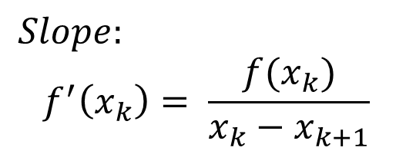
Geometrical Interpretation
$$Slope:$$
$$f^{′}\left(x_{k}\right)= \frac{f(x_{k})}{x_{k}−x_{k+1}}$$
$$Slope:$$
$$f^{′}\left(x_{k}\right)= \frac{f(x_{k})}{x_{k}−x_{k+1}}$$

Slide 7
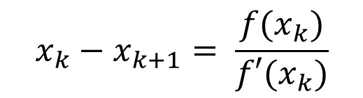
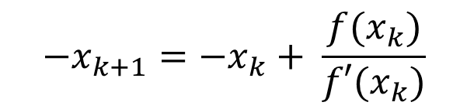
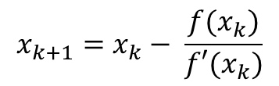

Geometrical Interpretation
$$Slope:$$
$$f^{′}\left(x_{k}\right)= \frac{f(x_{k})}{x_{k}−x_{k+1}}$$
$$x_{k}−x_{k+1}= \frac{f(x_{k})}{f′(x_{k})}$$
$$−x_{k+1}={−x}_{k}+ \frac{f(x_{k})}{{f′(x}_{k})}$$
$$−$$
$$x_{k+1}=x_{k}− \frac{f(x_{k})}{{f′(x}_{k})}$$
Newton-Raphson Formula

